Slide 1
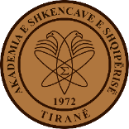
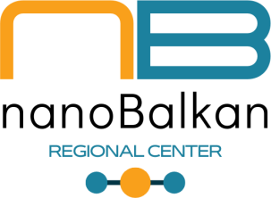
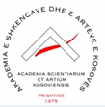
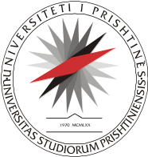
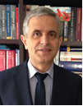
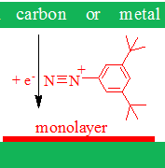
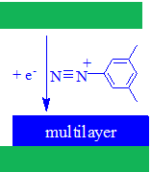
SURFACE MODIFICATION OF MATERIALS WITH NANOMETRIC ORGANIC LAYERS
Contact person/Group leader:
Prof. Dr. Fetah I. Podvorica
Affiliation
Academy of Sciences and Arts of Kosova,
Department of Chemistry, Faculty of Natural Sciences, University of Prishtina, Kosova
Department of Pharmacy, Faculty of Medecine, University of Prishtina, Kosova
Mail address
Rr. Agim Ramadani” nr 305, 10000 Prishtina, Kosova
Email/website
fetahpodvorica@ashak.org, fetah.podvorica@uni-pr.edu
https://staff.uni-pr.edu/profile/fetahpodvorica
Prof. Fetah I. Podvorica; Prof. Avni Berisha; Prof. Rame Vataj,
Dr. Imer Sadriu, Msc. Gentiana Hasani
Group Members
Google Scholar
https://scholar.google.com/citations?user=okCcEFAAAAAJ&hl=fr
Scopus
https://www.scopus.com/authid/detail.uri?authorId=6506285187
Research lines
Electro-chemical modification of the surfaces of materials with 2D nanometer organic films derived from aryl diazonium salts and some other organic moieties. The method is easy to perform and is compatible with a wide range of materials of massive electrodes made on carbon, metals, semiconductors and nanomaterials surfaces including graphene, carbon nanotubes, gold nanoparticles, gold nano-rods, quantum dots.
Use of the strongly attached organic layers to prepare nano-composites for various applications in bio-sensing, micro and molecular electronics or as a platform for post modifications.

